Slide 1
METS 2.0
This is an early-stage proposal for community feedback

Slide 2
Outline
Introduction
Reintroduce past work
Reimagining METS
Brainstorming and Affinity Analysis
Overarching Principles and Goals
New Model
Concrete Examples

Slide 3

Reimagining METS: An Exploration for Discussion (White Paper April 2011) https://github.com/mets/wiki/blob/master/wiki%20documents/METS%202.0/METSNextGeneration_vs16April2011.doc?raw=true
METS has an almost 15-year history (yesterday’s presentation)
Given the changing digital library landscape:
Is the current METS Schema and data model adequate for the communities’ changing needs?
How can METS evolve to better support the communities' needs?
Is there still a need for METS?
METS Strengths
METS Weaknesses
New Metadata Technologies and Trends
Successful Uses of METS
METS Issues and Annoyances
Options for Future Directions

Slide 4

METS Strengths
Ability to express complex and varied structures for digital objects
Not just hierarchies but also arbitrary hyperlinking between entity divisions
Supports different media types including audio and video
Ability to easily embed multiple different metadata schema in a controlled manner
METS 1.x has been very stable almost since its first version
Core purposes and mechanisms for accomplishing those purposes unchanged
Deliberative process followed for introducing changes
Newer schema are backward compatible with all earlier documents
METS Profiles provide a standard mechanism for METS producers and consumers to share details of a particular class of METS documents
Widely adopted particularly by cultural heritage institutions, such as national libraries and archives.

Slide 5

New Metadata Technologies and Trends
Trend toward starting from generalized abstract data models
METS lacks a formal data model and evolved more organically from pre-existing, pre-digital schema such as finding aids for analog content or MARC descriptive metadata
Trend toward alternate serializations of the abstract model, such as RDF/Linked Open Data serializations (Turtle, etc.), or JSON, in addition to XML
The entire METS standard is embodied in an XML Schema with supporting documentation, much of it derived from comments in the XML Schema
Peer standards such as PREMIS, MODS, and others are evolving in this direction

Slide 6
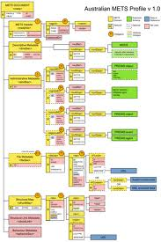
Successful Uses of METS (Encoding)
METS has dealt successfully with encoding varied complex digital objects (flexible structural map divisions)
Image Content
Multiple resolutions and formats
Structure and sequencing
Mixed Content
Same and differing levels of granularity
Audio/Video
par, seq, and area for complex interrelated streams with component parts
METS and EAD

Slide 7
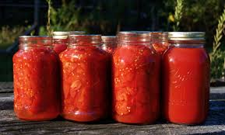
Successful Uses of METS (Preservation)
METS is widely used for aggregating, coordinating, and managing content and metadata for preservation purposes
Aggregation of all content and metadata through embedding or referencing
Inline XML
Base-64 encoded binary content
Reference external content and metadata
Reference other METS documents with mptr
Segmented metadata for descriptive, administrative, and structural metadata
File manifests
Guidelines for using METS and PREMIS together
OAIS Information Packages (SIPs, AIPs, DIPs)

Slide 8

Not So Successful Uses of METS (Web Archiving)
METS and WARC (standard web archiving format) not easily integrated
Treat WARC file as a whole
Unpack WARC file
Unmanageably large size

Slide 9
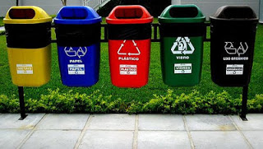
Not So Successful Uses of METS (Metadata Sections)
Segregating metadata into specialized containers
Not always clear were certain metadata should reside
Overlap between embedded schema
Creates discrepancies between different profiles

Slide 10

Not So Successful Uses of METS (Exchange / Interoperability)
Schema very flexible, loosely defined
Successful exchange requires external profiles and close cooperation between parties
Linking between sections in a METS document using ID/IDREFS attributes is inconsistently applied
For interoperability with other schema, such as OAI-ORE, much useful information is somewhat buried in various attributes
Often embedded schema have overlapping properties with METS, such as PREMIS

Slide 11

Not So Successful Uses of METS (Example of Fedora Commons)
Fedora initially opted to use METS as their model for digital objects
Changes were made to METS to accommodate this (behaviorSec)
However, Fedora eventually decided to drop METS and design their own schema (FOXML)
METS was deemed too complex by Fedora’s users
METS was not abstract enough and testing indicated that its internal structures and linking mechanisms led to inefficient processing at large-scale
METS was not flexible enough to quickly respond to changes in the Fedora software or architecture
Even so, Fedora still has some support for METS as an import and exchange format under tightly controlled conditions

Slide 12

Not So Successful Uses of METS (Interoperability and METS Profiles)
METS is fundamentally a packaging format and not an exchange/interoperability format
Lacks specificity needed for a consistent interpretation of the encoding
The goals of flexibility, extensibility, modularity, and abstraction can be at odds with the goal of interoperability
In reality interoperability may not be as important to the community as is widely held
METS Profiles were developed to facilitate interoperability between people, not between systems
Profiles are monolithic, no easy way to mix and match features between different profiles

Slide 13

Possible Future Directions
Flexibility versus constraints
Would a semantic web/linked data approach reduce some of the tension
A more tightly constrained XML schema with well defined extensibility points
Provide more formally defined relationships
Improve the use of global identifiers
Currently many METS elements only have an identity internal to the METS document
There is no formally defined mapping between internal METS elements and a global identifier, such as a URI
Difficult to extract and reuse specific parts of an object defined in METS
Would a semantic web/linked data approach provide a solution

Slide 14

Possible Future Directions (continued)
What core functions of METS should be in a new version
Packaging of files and metadata together (file manifest along with related metadata)
Structural representations of a objects (compound objects)
Relationships between related objects (datasets and the articles about the datasets) (OAI-ORE)
Behaviors, such as how objects should be rendered

Slide 15

Possible Future Directions (continued)
Better support for automated workflows
Minimize file size
Minimize redundancy
Restructure to optimize processing
How to better deal with standard vocabularies
How can METS utilize aspects of other related standards such OAI-ORE, BagIt, FOXML, PREMIS, etc.
Improved machine-actionable Profiles, maybe Schematron

Slide 16

Possible Future Directions (continued)
Maybe METS is good enough as is?
Instead of focusing effort on the design of METS, the Editorial Board should concentrate on the application of METS
Better usage guides
Best practices
Improving profiles
Continuing small incremental, and backward compatible changes as needed

Slide 17
Brainstorming and Affinity Analysis (May 2012)

Slide 18
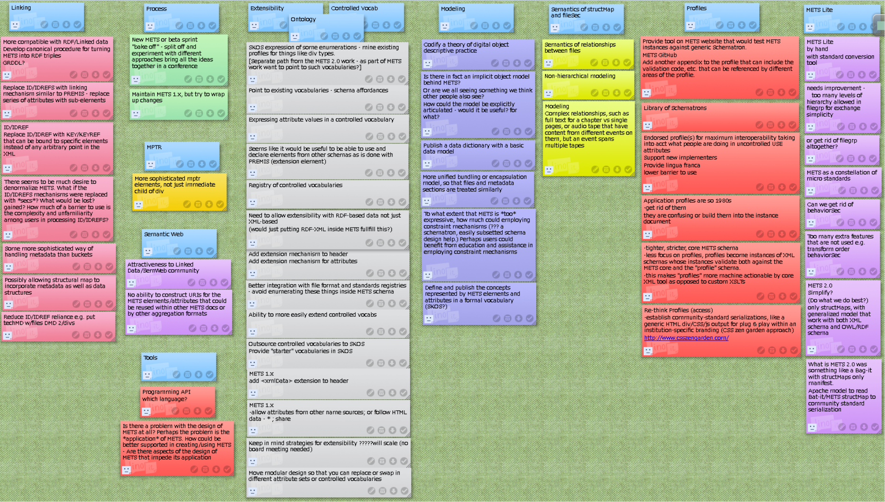
Linking
Compatible with or mapping to RDF/Link Data
Make internal linking ID/IDREFS work more like PREMIS
Use KEY/KEYREFS instead of ID/IDREFS
Do not segregate metadata into buckets
Instead of linking to metadata embed the metadata with the file or file groups or the structural divisions

Slide 19
Manage Process
How to maintain METS 1.x and also a new METS 2.x
MPTR
Should mptr be allowed in more places than just under the div
Semantic Web
How to make METS compatible with RDF
Provide URIs for internal METS elements

Slide 20
Extensibility, Ontology, Controlled Vocabs
SKOS
Point to existing vocabularies
Reuse elements from other schema in METS
Add extensibility to metsHdr (add xmlData)
Add extensibility to attributes (already done in METS 1.10)
Do not enumerate controlled vocabs in XML Schema

Slide 21
Modeling
Is there an implicit object model behind METS? Can this be made explicit? (yesterday’s presentation).
Should METS have a data dictionary (similar to PREMIS)?
Treat content and metadata the same in terms of the core model
How can METS be dynamically constrained? Schematron, Creating redefinitions/restrictions of the base XML Schema

Slide 22
Semantics of structMap and fileSec
Improve the modeling of non-hierarchical structures
Define a way to establish semantically defined relationships between files.
Better support for complex relationships, such as chapters versus pages, audio streams that span multiple files, etc.

Slide 23
Profiles
Schematron
Add appendix to profile schema for schematron validation code
Develop a modular library of schematron validations
Provide some “endorsed” profiles that embody best practices
Deprecate profiles altogether
Instead tighten up core model/schema so profiles would not be needed

Slide 24
METS Lite
Create a “METS Light” simplified schema with transformation to the complete schema
Do not allow nested file groups
Get rid of file group altogether
Get rid of behavior section
Simplify to what METS does best
Just structural maps with multiple serializations
Maybe structural maps contained in a Bag-It
Find an alternative to xlink

Slide 25
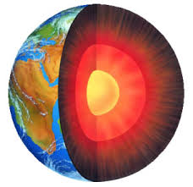
Core Principles or Goals for METS 2
Closer alignment with peer standards such as PREMIS and MODS
Also related standards like OAI-ORE and BagIt
Support for Semantic Web/Linked Data, but also with a standard XML Schema (maybe similar to what PREMIS has done)
Does not need to be backward compatible with METS 1.x
Path from 1.x to 2.0 would be nice
Improved extensibility
Controlled vocabularies can be added or modified w/o requiring schema changes
Reuse existing schema when possible, especially PREMIS
Supports Core Functions
Packaging/File Manifest/Inventory of collections of files and associated metadata
Represent Complex/Compound Objects

Slide 26
Recap of Yesterday’s 1.x Model

Slide 27
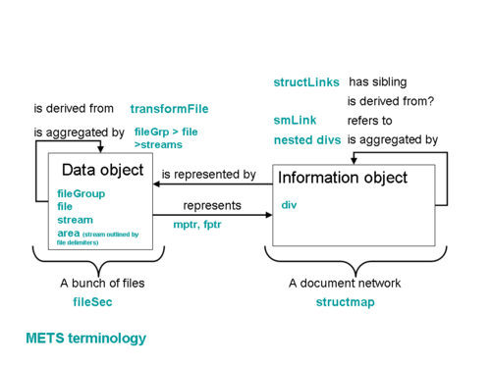
Simplifications (based on 1.x model from yesterday)

Slide 28
Tying Together METS, PREMIS, OAI-ORE
METS
Structural Map
METS
Div
METS
File
METS
Stream
METS
Document
PREMIS
Intellectual
Entity
PREMIS Object (representation, file, bitstream)
OAI-ORE
REM
OAI-ORE
Aggregation
OAI-ORE
Aggregated
Resource

Slide 29
Very Quick Intro to RDF and RDFS
Turtle Syntax (optional)
<subject> a <Class> .
_:blanknode a <Class> .
<subject> <predicate> <object> .
<subject> <predicate> “literal” .
<subject> <predicate1> <object1> ; <predicate2> <object2> ; <predicate3> <object3> .
<subject> <predicate> <object1> ,
<object2> ,
<object3> .
<subject> <predicate> ( <object1>
<object2> <object3> ) .
parent predicate
rdfs:subPropertyOf
subject
predicate
object
predicate
rdf:type
“literal”
Class
rdfs:subClassOf
Parent Class

Slide 30
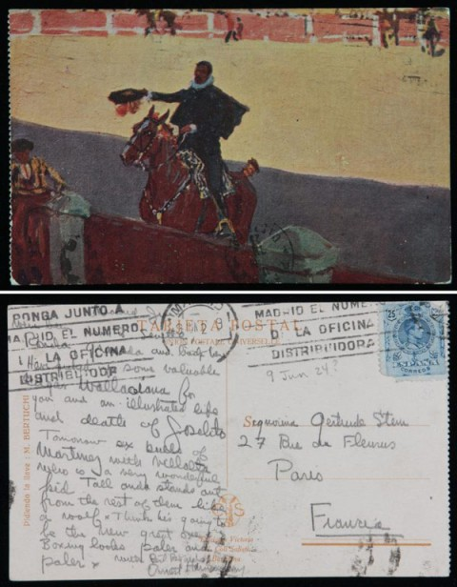
Simple Example
Postcard
Each side digitized as a separate hi-res images along with a derived thumbnail images
A transcription of the written text on the back
MODS descriptive metadata record for the postcard
Basic technical metadata for all files: format, size, checksum

Slide 31
METS Document (similar to OAI-ORE REM?)
Provenance information about the METS Document by way of PREMIS Events (Likewise for rights if needed)
<Postcard METS Document>
premis:hasEvent
<Creation Event>
premis:hasEventRelatedAgent
<Curator Agent>
rdf:type
premis:hasRights
METS Document
<Rights>
premis:hasRightsRelatedAgent
<Rightsholder Agent>
rdfs:subClassOf
PREMIS File

Slide 32
METS Document describes one or more structural maps
<Postcard METS Document>
rdf:type
mets:hasStructuralMap
<Root METS Division>
METS Document
rdf:type
rdfs:subPropertyOf
METS Division
rdfs:subClassOf
premis:hasRelationship
rdfs:subClassOf
PREMIS File
PREMIS Representation

Slide 33
Descriptive Metadata
<Root METS Division>
<MODS File>
mets:hasDescriptiveMetadata
rdfs:subPropertyOf
rdf:type
METS File
mets:hasMetadata
rdfs:subPropertyOf
rdfs:subClassOf
PREMIS File
premis:hasRelationship
For other relationships see also:
http://id.loc.gov/vocabulary/preservation/relationshipType.html and http://id.loc.gov/vocabulary/preservation/relationshipSubType.html

Slide 34
Compound Object Divisions
<Root METS Division>
mets:hasPart
<Postcard Front>
mets:hasPart
<Front Image>
mets:hasPart
<Postcard Back>
mets:hasPart
<Back Image>
rdfs:subPropertyOf
ALL
premis:hasRelationship
rdf:type
mets:hasPart
METS Division
<Back transcription>
rdfs:subClassOf
PREMIS Representation

Slide 35
Manifestations of a Division
mets:hasManifestation
rdfs:subPropertyOf
<Front Image>
mets:hasManifestation
<Front Hi-res TIFF>
premis:hasRelationship
mets:hasManifestation
<Front Thumbnail PNG>
rdf:type
METS File
<Back Image>
mets:hasManifestation
<Back Hi-res TIFF>
mets:hasManifestation
<Back Thumbnail PNG>
rdfs:subClassOf
PREMIS File
<Back transcription>
mets:hasManifestation
<Back Text>

Slide 36
Using a Local (or other) Vocabulary for Manifestations
mets:hasManifestation
rdfs:subPropertyOf
<Front Hi-res TIFF>
my:hasHiResImage
<Front Image>
my:hasThumbnailImage
<Front Thumbnail PNG>
rdfs:subPropertyOf
mets:hasManifestation

Slide 37
File Characteristics (use PREMIS properties)
<Front Hi-res TIFF>
premis:hasObjectCharacteristics
_:characteristics
premis:hasSize
“1234567”
rdf:type
premis:hasFixity
<premis:Object Characteristics>
premis:hasFormat
_:fixity
<info:pronom/fmt/353>
premis:hasMessageDigestAlgorithm
premis:hasCompositionLevel
premis:hasMessageDigest
“0”
<http://id.loc.gov/.../md5>
“7c9b35da…24419563”

Slide 38
Embedded Content http://www.w3.org/TR/Content-in-RDF10/
<Back Text>
cnt:chars
rdf:type
rdf:type
“Dear
…
Ernest Hemmingway”
METS File
cnt:ContentAsText
Also
ContentAsBase64
and
ContentAsXML

Slide 39
Turtle
<http://.../postcard123.mets> a <mets:MetsDocument> ; <premis:hasEvent> _:creationEvent1 ; <mets:hasStructuralMap> <http://.../postcard123.mets#div1> .
<http://.../postcard123.mets#div1> a <mets:Division> ; <mets:hasDescriptiveMetadata> <http://.../postcard123.mods> ; <mets:hasPart> <http://.../postcard123.mets#front> ; <mets:hasPart> <http://.../postcard123.mets#back> .
<http://.../postcard123.mets#front> a <mets:Division> ; <mets:hasPart> <http://.../postcard123.mets#frontImage> .
<http://.../postcard123.mets#back> a <mets:Division> ; <mets:hasPart> <http://.../postcard123.mets#backImage> ; <mets:hasPart> <http://.../postcard123.mets#backTranscription> .
<my:hasThumbnailImage> <rdfs:isSubpropertyOf> <mets:hasManifestation> .
<my:hasHiResImage> <rdfs:isSubpropertyOf> <mets:hasManifestation> .
<http://.../postcard123.mets#frontImage> a <mets:Division> ; <my:hasHiResImage> <http://.../postcard123_front.tif> ; <my:hasThumbnailImage> <http://.../postcard123_front.png> .
<http://.../postcard123.mets#backImage> a <mets:Division> ; <my:hasHiResImage> <http://.../postcard123_back.tif> ; <my:hasThumbnailImage> <http://.../postcard123_back.png> .
<http://.../postcard123.mets#backTranscription> a <mets:Division> ; <mets:hasManifestation> <http://.../postcard123_back.txt> .
<http://.../postcard123_back.txt> a <mets:File>, <cnt:ContentAsText> ; <premis:hasObjectCharacteristics> _:characterstics1 ; <cnt:chars> "Dear ... Ernest Hemmingway" .
_:characterstics1 a <premis:ObjectCharacteristics> ; <premis:hasSize> "123" ; <premis:hasFormat> <info:pronom/fmt/353> ; <premis:hasCompositionLevel> "0" ; <premis:hasFixity> _:fixity1 .
_:fixity1 a <premis:Fixity> ; <premis:hasMessageDigestAlgorithm> <http://id.loc.gov/vocabulary/cryptographicHashFunctions/md5> ; <premis:hasMessageDigest> "AAAAAAAAAAAAAAAAAAAAAAAAAAAAAAAA" .
_:creationEvent1 a <premis:Event> ; ...

Slide 40
Other Properties
METS Division, File, FilePart, and others are subclasses of PREMIS Representation, File, Bitstream and others, respectively
Therefore, the various PREMIS properties can be used on the sub-classed METS classes
This also includes linking PREMIS Events, Rights, and Agents to these classes
Plus some of the existing METS properties will be used
<Back Image>
mets:use
<my:use_vocab>
rdf:type
mets:label
mets:status
<my:status_vocab>
METS Division
“Some Text”
premis:*
rdfs:subClassOf
<something>
PREMIS
Representation

Slide 41
More Examples
METS Parallel Files <par>
METS Sequential Files <seq>
METS Portion or Area of File <area>
Ordered and labeled divisions
Possibly using <premis:RelatedObjectIdentification>

Slide 42
METS Parallel Files <par>
<video>
mets:hasManifestation
rdf:type
<movie>
METS File
mets:hasManifestation
rdf:type
rdf:type
<audio>
METS Parallel
rdfs:subClassOf
PREMIS Representation

Slide 43
METS Sequential Files <seq>
<image1>
rdf:type
mets:hasManifestation
<image2>
METS File
<slideshow>
rdf:type
<image3>
rdf:type
rdf:type
METS Sequence
rdf:type
METS FileList
rdfs:subClassOf
rdfs:subClassOf
PREMIS Representation
<rdf:List>

Slide 44
METS Portion or Area of File <area> http://www.openannotation.org/spec/core/specific.html#Selectors
<track 1>
<audio file>
rdf:type
METS File
mets:hasManifestation
oa:hasSource
rdf:type
<audio fragment>
oa:hasSelector
METS Division
rdf:type
_:selector
rdf:type
<oa:Data Position Selector>
rdf:type
METS FilePart
<oa:SpecificResource>
Also
Fragment Selector
(http://www.w3.org/TR/media-frags/) ,
Text Position Selector,
Text Quote Selector,
SVG Selector,
and other local selectors
rdfs:subClassOf
oa:start
oa:end
PREMIS Bitstream
“0”
“4321”

Slide 45
Ordered and labeled METS divisions
<chapter 1>
mets:hasPart
_:related1
mets:hasManifestation
<page 1>
rdf:type
rdf:type
mets:order
mets:orderLabel
METS RelatedObject
“1”
“Page 1”
mets:hasPart
METS File
rdf:type
rdf:type
PREMIS RelatedObjectIdentification
rdf:type
_:related2
mets:hasManifestation
<page 2>
mets:order
mets:orderLabel
“2”
“Page 2”

Slide 46
Namespaces
mets -- http://www.loc.gov/METS2/rdf/v1#
premis -- http://www.loc.gov/premis/rdf/v1#
oa -- http://www.w3.org/ns/oa#
cnt -- http://www.w3.org/2011/content#
rdf -- http://www.w3.org/1999/02/22-rdf-syntax-ns#
rdfs -- http://www.w3.org/2000/01/rdf-schema#
Others?

Slide 47
METS Classes and Properties used in these examples
Classes
mets:Document, mets:Division, mets:File, mets:Parallel, mets:Sequence, mets:FilePart, mets:FileList, mets:RelatedObject, …
Properties
mets:hasStructuralMap, mets:hasMetadata, mets:hasDescriptiveMetadata, mets:hasPart, mets:hasManifestation, mets:order, mets:orderLabel, met:use, mets:status, mets:label, …

Slide 48
Where to go from here?

